Slide 1
Yelp Reviews Classification - NLP
By Sarayu Ravindran

Slide 2
Problem Statement
This project covers the topic of natural language processing or NLP to classify user-generated text and determine their intent. The goal of this project is to build a model that can classify 10,000 Yelp reviews into either one-star or 5-star reviews. To accomplish this, the project uses NLP techniques to process and clean the text from the reviews, and then train the model using the clean text. The model is then evaluated and analyzed to measure accuracy and performance.

Slide 3
Objectives
To analyze Yelp-style customer reviews using Natural Language Processing (NLP) techniques for sentiment classification and prediction of star ratings.
The model can then be used to predict the label for new, unseen reviews. This can be especially useful for businesses, as it can help them identify patterns in customer feedback and make improvements to their products or services.

Slide 4
Literature Review
Importance of Online Reviews
Yelp has emerged as a popular platform for user-generated reviews, significantly impacting consumer behavior and business reputation. Several studies have shown that both the sentiment and volume of reviews can influence business success.
NLP in Review Analysis
Natural Language Processing (NLP) is extensively used to:
Extract sentiment polarity (positive/negative/neutral)
Identify aspects/topics (e.g., service, food, ambiance)
Detect fake/spam reviews
Summarize reviews for quick insights

Slide 5
Literature Review
Key Research Contributions:
Pang & Lee (2008): Early sentiment classification using machine learning techniques.
Liu (2012): Aspect-based sentiment analysis.
Yelp Dataset Challenge Papers: Use deep learning (e.g., LSTM, BERT) for review classification and business prediction.

Slide 6
Exploratory Data Analysis
Dataset Overview:
Source: Yelp Open Dataset
Fields: review_id, user_id, business_id, stars, date, text
Text Preprocessing:
Removal of Punctuation
Lowercasing
Tokenization
Stopword removal
Sentiment Analysis:
Polarity analysis
Word Clouds:
Positive Reviews
Negative Reviews

Slide 7
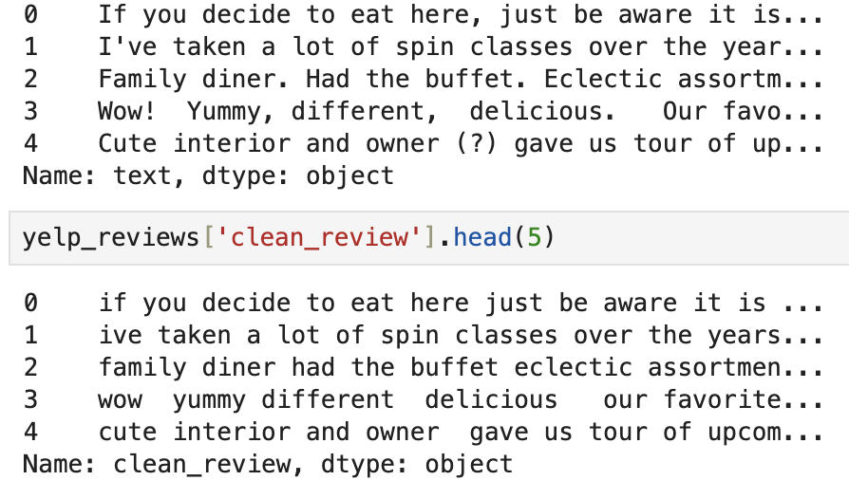
Exploratory Data Analysis
Text Preprocessing:
Removed punctuation and converted all text to lowercase.

Slide 8
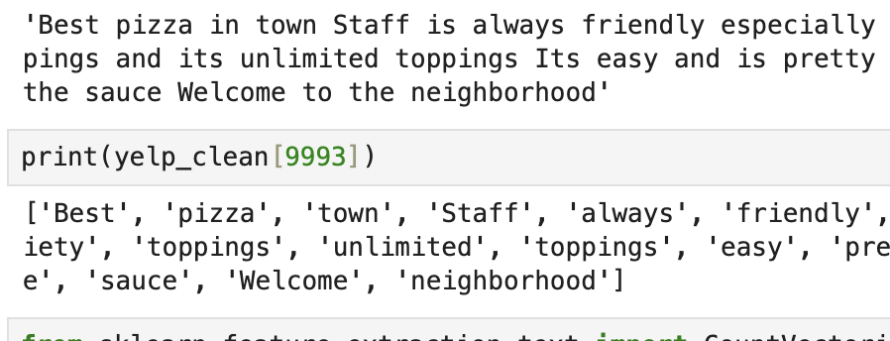
Exploratory Data Analysis
Text Preprocessing:
Tokenization iis the process of breaking strings into tokens
Stopword Removal

Slide 9
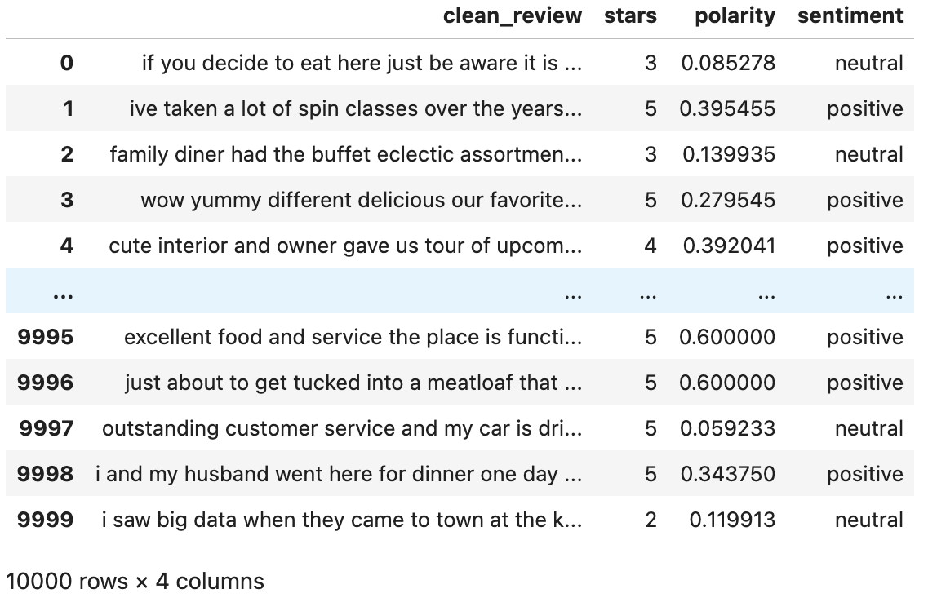
Exploratory Data Analysis:
Sentiment analysis:
It is the process of detecting positive or negative sentiment in text. It’s often used by businesses to detect sentiment in social data, gauge brand reputation, and understand customers.
Used TextBlob to perform sentiment polarity analysis.

Slide 10
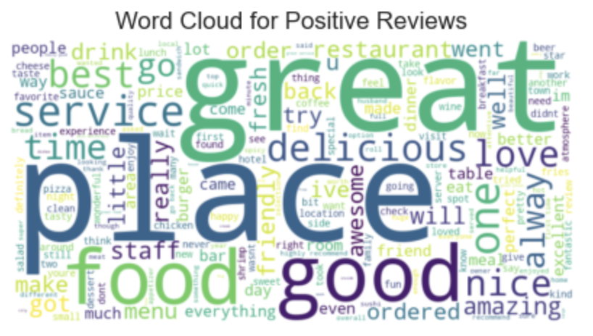
Exploratory Data Analysis:
Word Clouds:
Positive Reviews: Common keywords include great, delicious, good, nice.

Slide 11
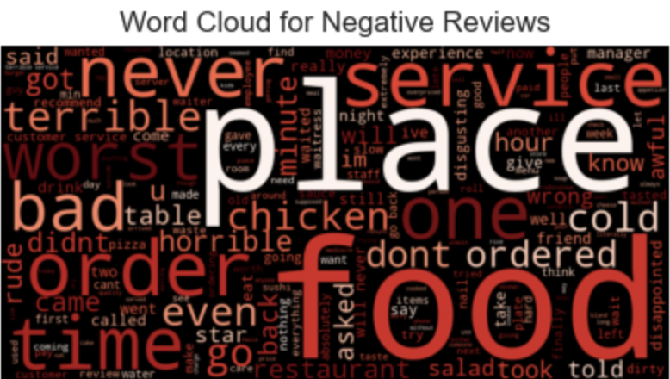
Exploratory Data Analysis:
Word Clouds:
Negative Reviews: Common keywords include bad, never, terrible, rude.

Slide 12
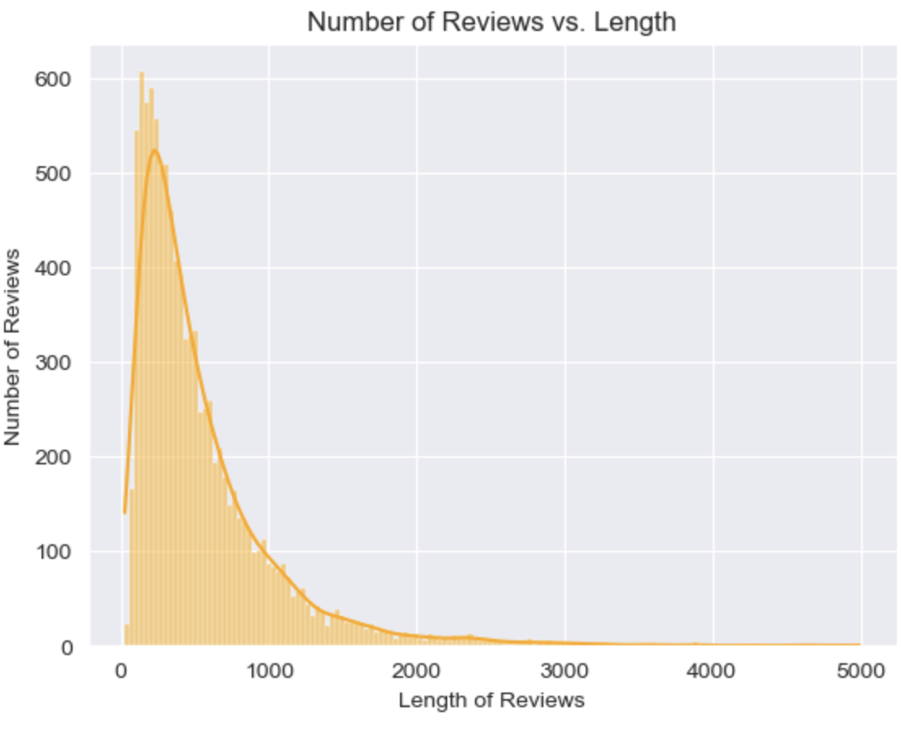
Exploratory Data Analysis:
Length of Reviews Vs. No.of Reviews
The histogram tells us that the length of the reviews is positively skewed.

Slide 13
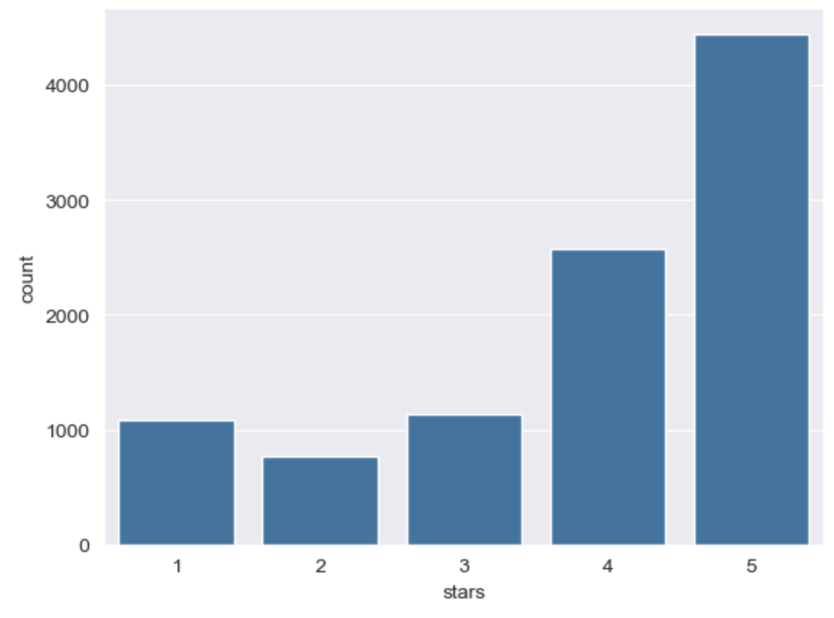
Exploratory Data Analysis:
Count of Reviews Vs. Ratings

Slide 14
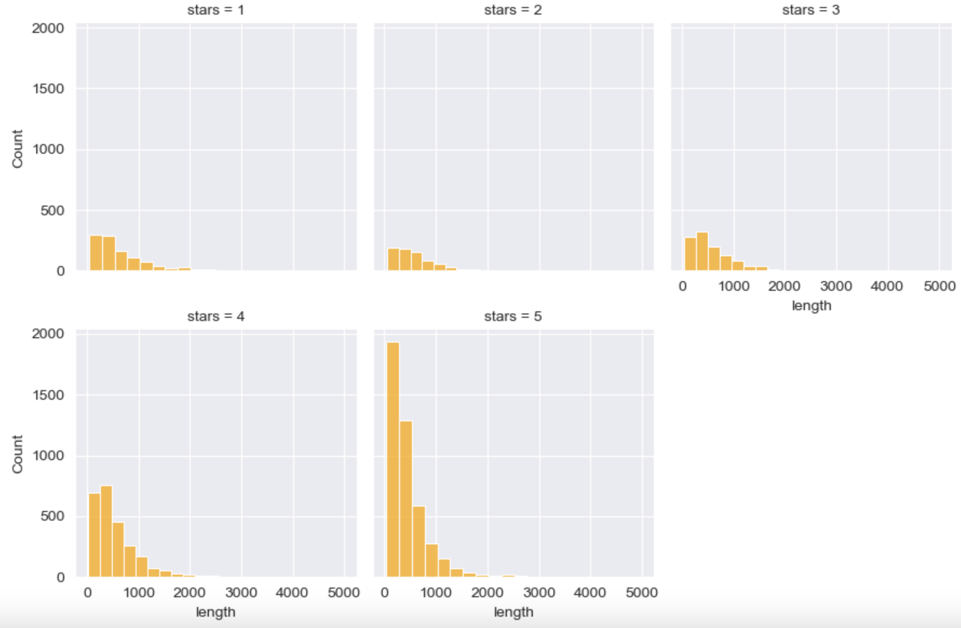
Exploratory Data Analysis:
Count of Star Vs. Length
Created graphs for each group of star counts (1 to 5) and their lengths, we can see that the length increases as the number of stars increases

Slide 15
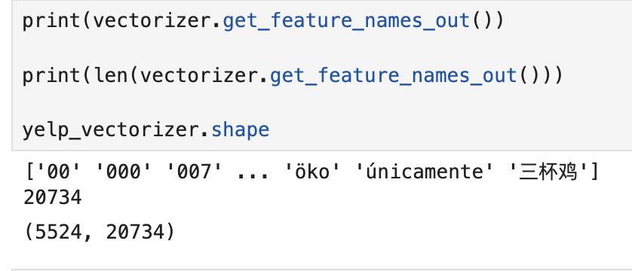
Model Training and Evaluation:
Creating Count Vectorizer:
The count vectorizer will fit around our clean data and then transform into a matrix of words and frequencies. It converts text into numerical representation by creating a matrix that shows the frequency in occurences of tokenized words. The text input is tokenized into words or n-grams (small groups of words) and then counts each occurence of that group.
Our count vectorizer matrix has 20734 unique words from 5524 reviews.
(X) will be the count vectorizer which stores the frequency of all the uncommon words
The dependent variable (y) is the labeled star count

Slide 16
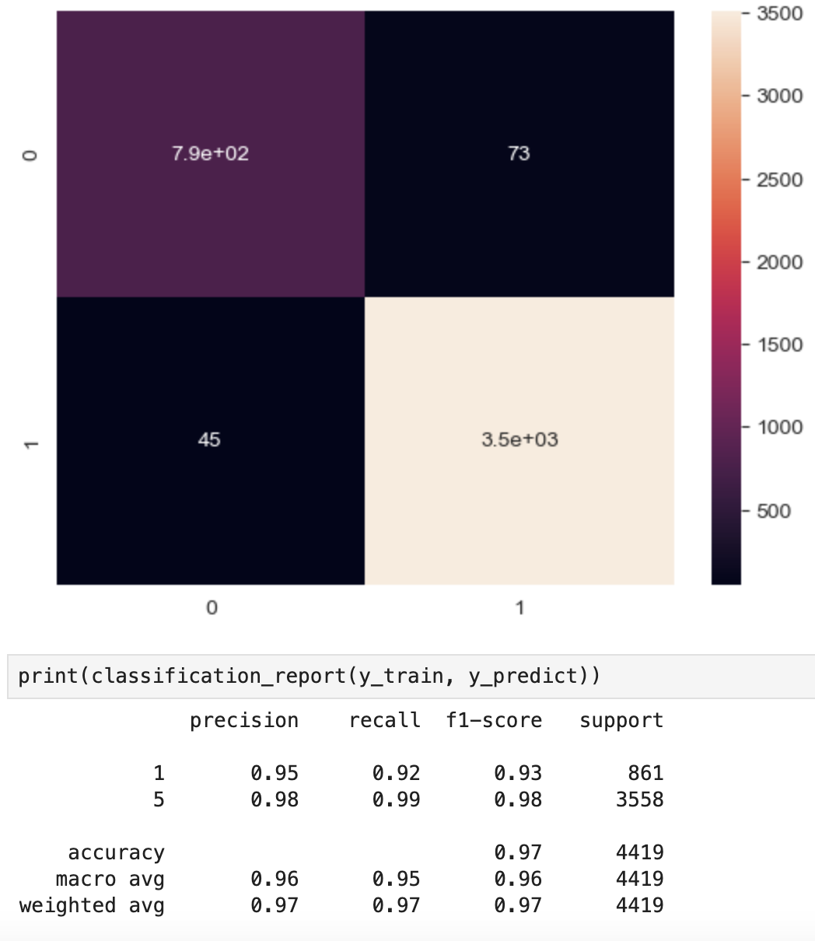
Model Training and Evaluation:
Analyzing the training data:
Created a confusion matrix comparing the training set predicted labels and the true labels, plot the confusion matrix on a heatmap. The top left square refers to the true positive, or positive labels being classified correctly. The top right square is the number of samples misclassified as false positives. The bottom right square refers to the true negatives, or the number of negative labels identified correctly. The bottom left square is the number of samples misclassified as false negatives
The model's training accuracy is 97%

Slide 17
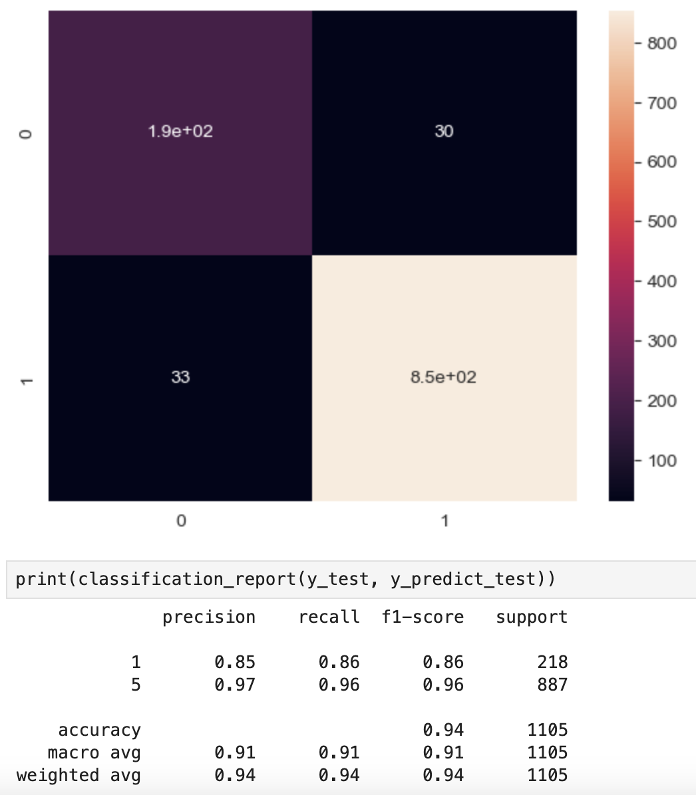
Model Training and Evaluation:
Analyzing the testing data:
According to our confusion matrix, 30 samples were misclassified as false positives and 33 misclassified as false negatives.
The model's testing accuracy is 94%

Slide 18
Result Interpretation:
High Accuracy: Both training and testing accuracies are high, which shows that the model has learned the patterns in the training data well and is able to generalize those patterns to unseen test data effectively.
Low Overfitting: The small difference (3%) between training and testing accuracy suggests that the model is not overfitting. Overfitting would be indicated by a high training accuracy but a much lower testing accuracy.
Model Suitability: Since MultinomialNB is particularly effective for text classification problems, this result implies that the dataset (likely involving word frequencies or counts, as in NLP tasks like sentiment analysis) is well-suited to this classifier.

Slide 19
Conclusion:
The Naive Bayes model demonstrates excellent performance and generalization. Given the small gap between training and testing accuracy, we can conclude:
The model is well-trained.
It is not memorizing the data.
It is suitable for real-world predictions, assuming the data distribution remains similar.

